Slide 1
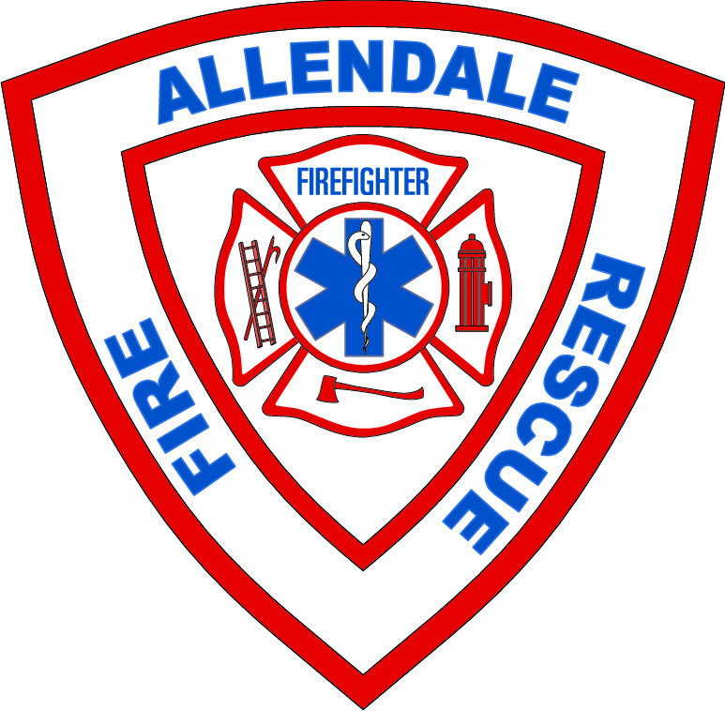

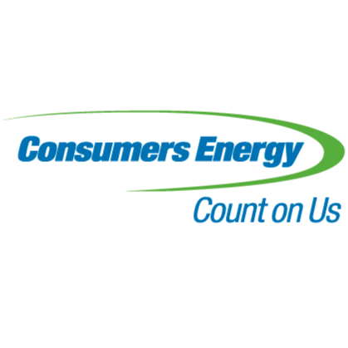
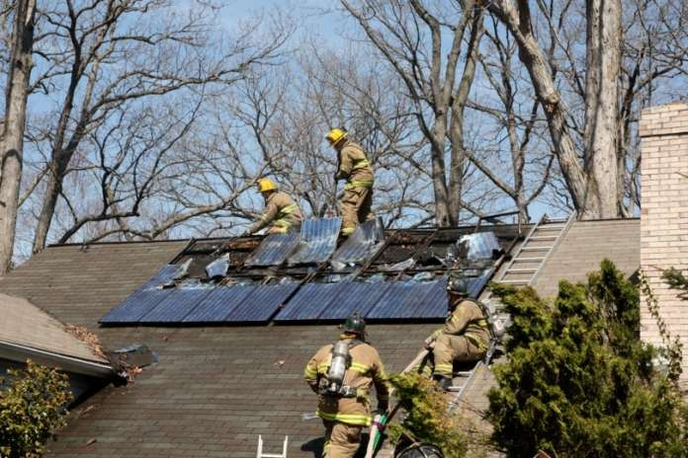
Solar Panels Photovoltaic (PV) Systems Emergency Operations
First Responder Safety Training
Sponsored by
Grand Valley State University
Allendale Fire Rescue
Consumers Energy
DRAFT

Slide 2

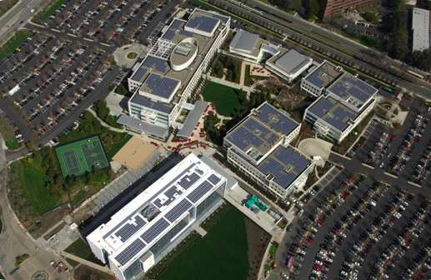
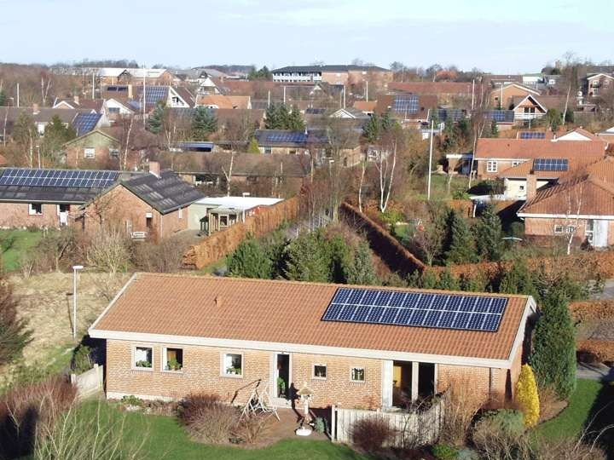
Introduction To Photovoltaic Systems
Characteristics and Equipment
EBay Headquarters, San Jose, CA
Residential Use of PV Systems

Slide 3
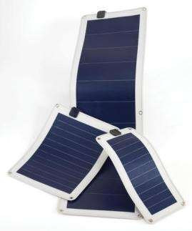
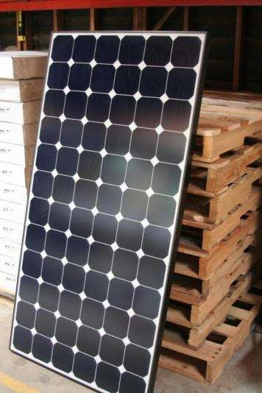
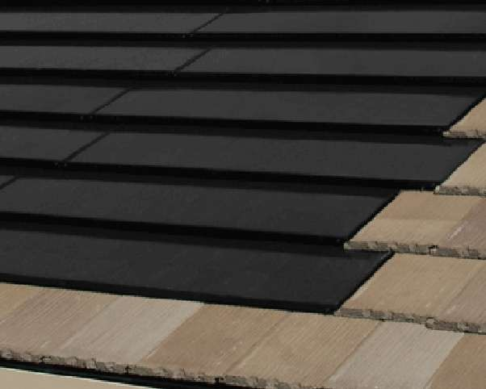
Solar power is obtained through PV (photovoltaic) systems
One solar cell produces about .5 volts
60 to 72 cell modules are common
One system may have many modules
PV modules come in many shapes and sizes
Framed
Building Integrated Photovoltaic (BIPV)
Can be difficult to determine
Flexible Laminate
Made of a positive boron layer, a negative phosphorus layer, and a silicon or amorphous cell
Flexible Laminate
Photo courtesy of Uni-Solar
Framed PV Module
Photo by M. Paiss
Building Integrated

Slide 4
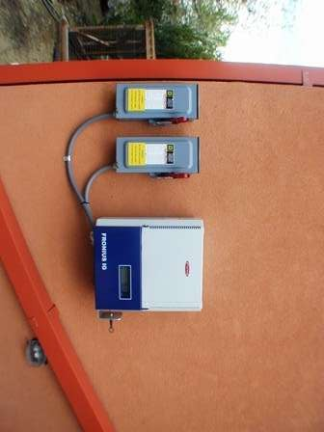
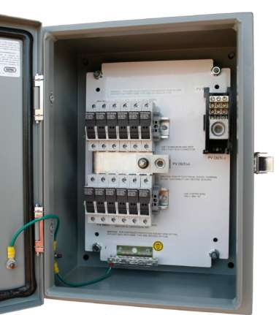
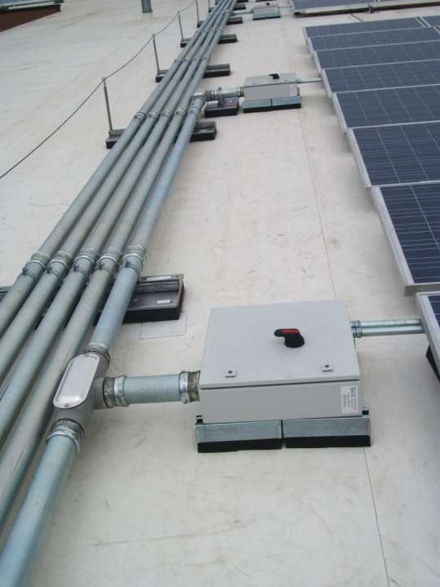
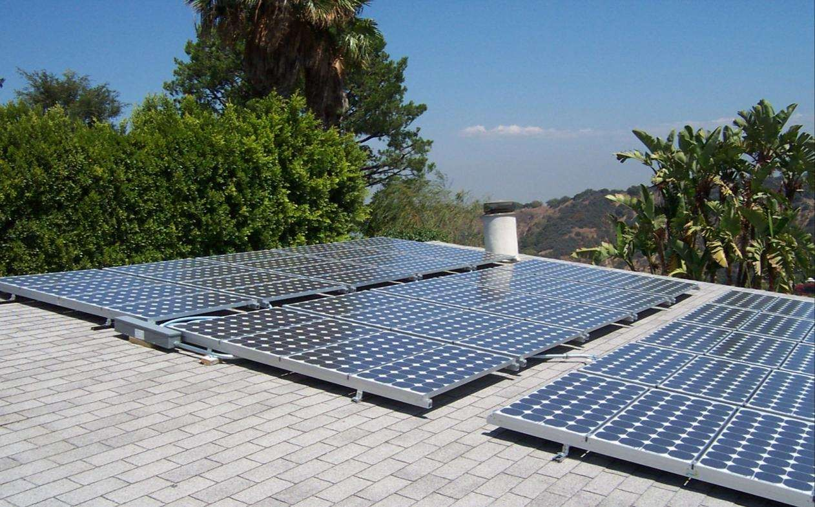
Components of PV Systems:
Inverters
Photo courtesy of Independent Energy Systems
Inside of Combiner box
Wiring (conductors, combiner boxes, conduit, disconnects)
Array (PV modules and mount)

Slide 5
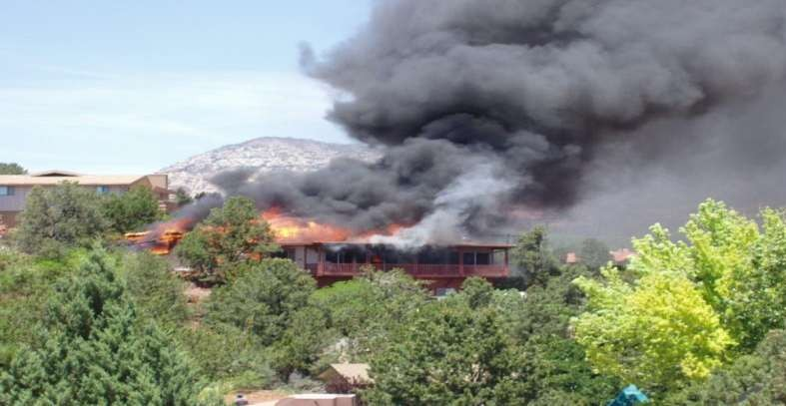
PV Hazard Identification
PV fires:
May look like roof fires
May not be apparent that it’s a PV fire until on site
Notes:
PV fires may often look like roof fires. You may not know what you are dealing with until you are on site.

Slide 6
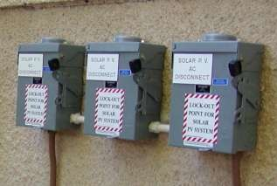
PV Identification
Determine if PV is present
Not all solar panels are alike
It’s easiest to look for labeling
Labeling could be on conduits, disconnects, and utility meters
Disconnects labeled as part of a PV system

Slide 7
PV Related Firefighter Hazards
Inhalation Exposure Hazards
Electrical Shock & Burns
Falls from Roof Operations
Roof Collapse
Batteries

Slide 8
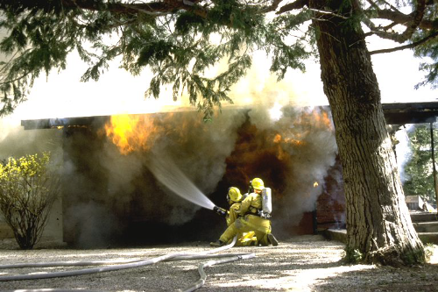
Inhalation Hazards:
Hazardous chemicals may be exposed to direct flame during a fire or explosion
In case of fire, shelter in place populations at risk downwind of fire
Chemicals that could be in PV modules:
Boron- No health effects to humans or the environment
Cadmium Telluride- A known carcinogen, the primary route of exposure is inhalation
Gallium Arsenide- The health effects have not been studied, it is considered highly toxic and carcinogenic
Phosphorus- The fumes from compounds are considered highly toxic. NIOSH recommended exposure limit to phosphorus is 5 mg/m3. A lethal dose of phosphorus is 50 milligrams

Slide 9
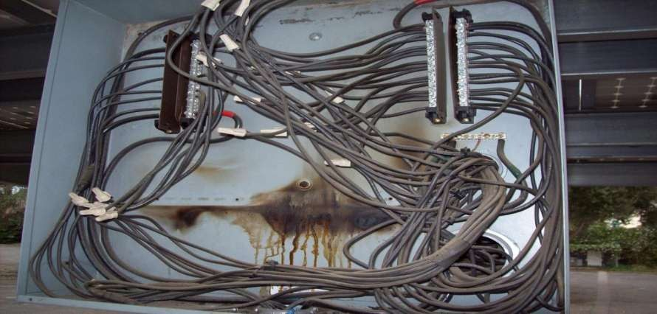
Electrical Hazards:
Electricity can cause a variety of effects, such as a slight tingling sensation, involuntary muscle reaction, burns, and death
The physiological effects produced by electricity can vary based on variables in human resistance to electricity
These Include:
Amount of current
Path of current
Length of time the body is in the current
Body shape and size
Area of contact
Pressure of contact
Moisture of contacts
Clothing and jewelry
Type of skin
Involuntary muscle reaction could cause firefighter to fall
Stay 20 feet or more from live equipment for solid stream and 5 or more feet away for a dispersed stream

Slide 10
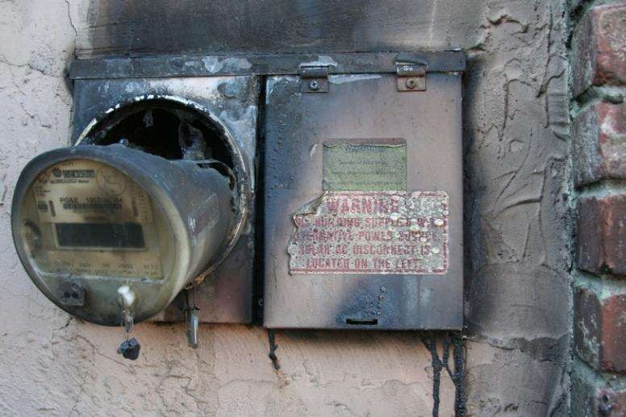
Electrical Hazards:
Electrical burns
Tissue damage occurs because the body is unable to dissipate the heat from the current flow
Electric arcs
Can melt nearby material, vaporize metal in close vicinity, burn flesh and ignite clothing at distances of up to 10 feet
Can reach temperatures 15,000 to 35,000 degrees
Never pull the electrical meter as a means of shutting down power to a building
This does not shut the power down and could create more hazards
Photo courtesy of M. Paiss

Slide 11
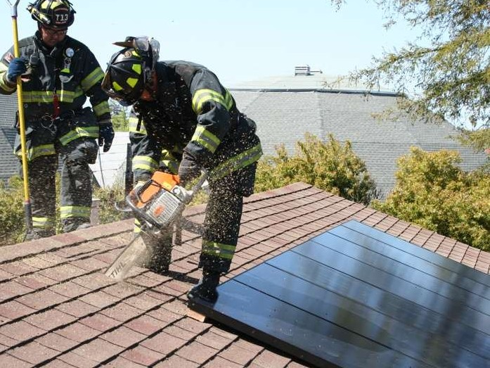
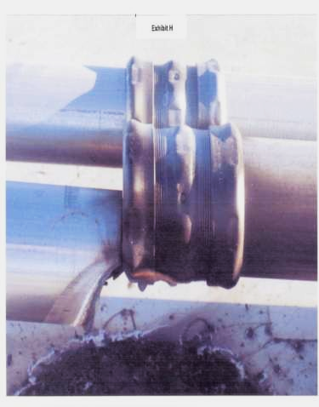
Roof Hazards:
Weight of the PV array on a weakening structure
You may not be able to access the roof over the fire
Roof top ventilation
Select a spot at the highest point of the roof and as close to the fire as possible
Cut hole in the roof to release hot gases and smoke out of the structure
Be careful not to cut through metal conduits, wiring, or PV modules
Trip Hazards on roof:
Roof vents
Skylights
Solar thermal panels
PV array

Slide 12
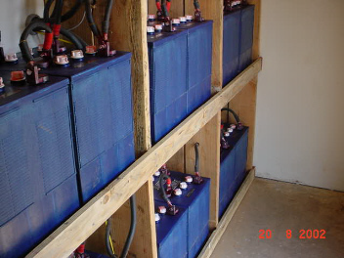
Battery Hazards:
Batteries do not burn easily, but can give off extremely corrosive fumes and gases if exposed to fire
Spilled electrolyte can react and produce toxic fumes and flammable and explosive gases when coming into contact with other metals
Prevent all open flames and avoid creating sparks
Use CO2, foam, or dry chemical fire extinguishers on lead-acid battery fires
If the battery is punctured by a conductive object, assume that the object is electrical potential

Slide 13
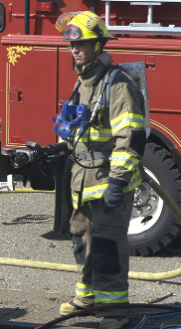
How to Reduce Exposure to PV Related Hazards
Personal Protective Equipment:
Firefighters should follow the minimum standard in NFPA 1971, Protective Ensemble for structural Firefighting and NFPA 1500, Chapter 7 Personal Protective Equipment
This would include: Turnout pants, turnout coat, boots, gloves, hood, helmet, SCBA
Typical firefighter boots and gloves aren’t safe with electrical hazards
Dry leather gloves and new rubber boots will protect attains some shock hazard
Do not use wet leather gloves, damaged metal toe boots, or leather boots
Use insulated hand tools around electrical circuits
To check for electricity flowing between two contacts and AC/DC meter should be employed
Hot sticks typically only detect alternating current, so they would not detect current in PV wiring or battery conductors

Slide 14
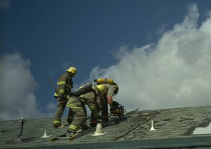
How To Approach An Emergency
First Steps:
Size-up: observe the roof and look for warning labels on electrical disconnects
Lock out and tag out: LOTO all electrical disconnects, isolating the PV system and the inverter
Ventilation: consider whether to use cross ventilation or rooftop ventilation and where to cut
Shelter-in-place: Decide if the size of the emergency and how the PV array is involved would put downwind populations in danger.
Shelter-in-place populations at-risk

Slide 15
Do Not Try to Be an Electrician
Do not tamper with equipment:
Don’t try to fix the broken equipment
Call Consumers Energy or company that installed solar PV system
Put out the fire and notify the technician

Slide 16
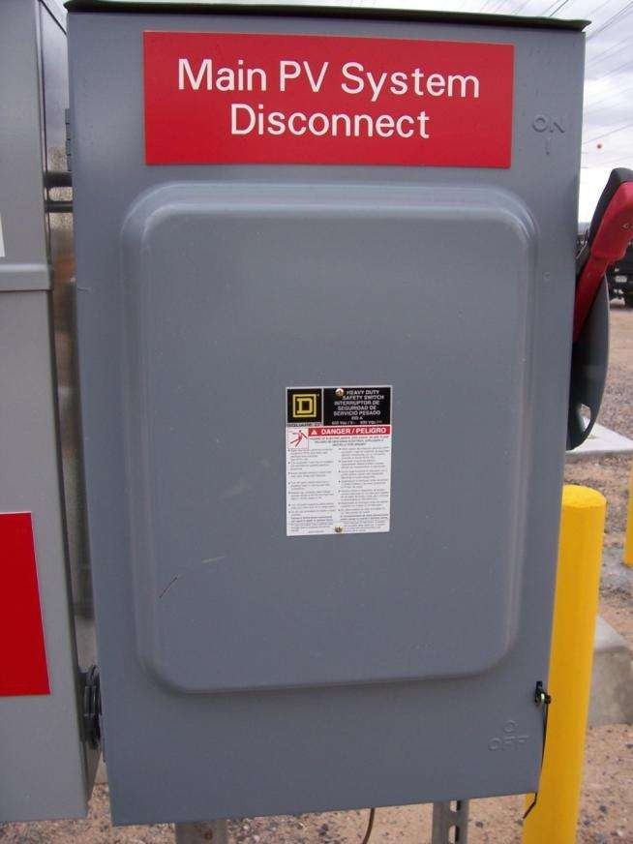
De-energizing the PV system:
The PV array will always generate some electricity
Light sources besides the sun can also energize the PV module
This could include lamps and fires
Walking on or breaking PV modules could release all the energy inherent in the system simultaneously
Disconnect sequence:
AC, Panel Main, Utility Service
DC 1, 2, and 3
Power will bleed down to 30 volts within 5 minutes

Slide 17
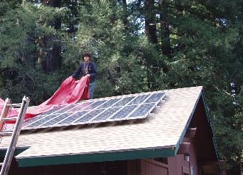
De-energizing the PV Modules:
Place dark colored canvas fire salvage cover on all modules in the array
Do not use wet covers
The salvage cover will significantly reduce sunlight to the array, but electricity can still be generated through the material of the salvage cover
Only when all strings in the array are covered is the entire system at a safe level

Slide 18
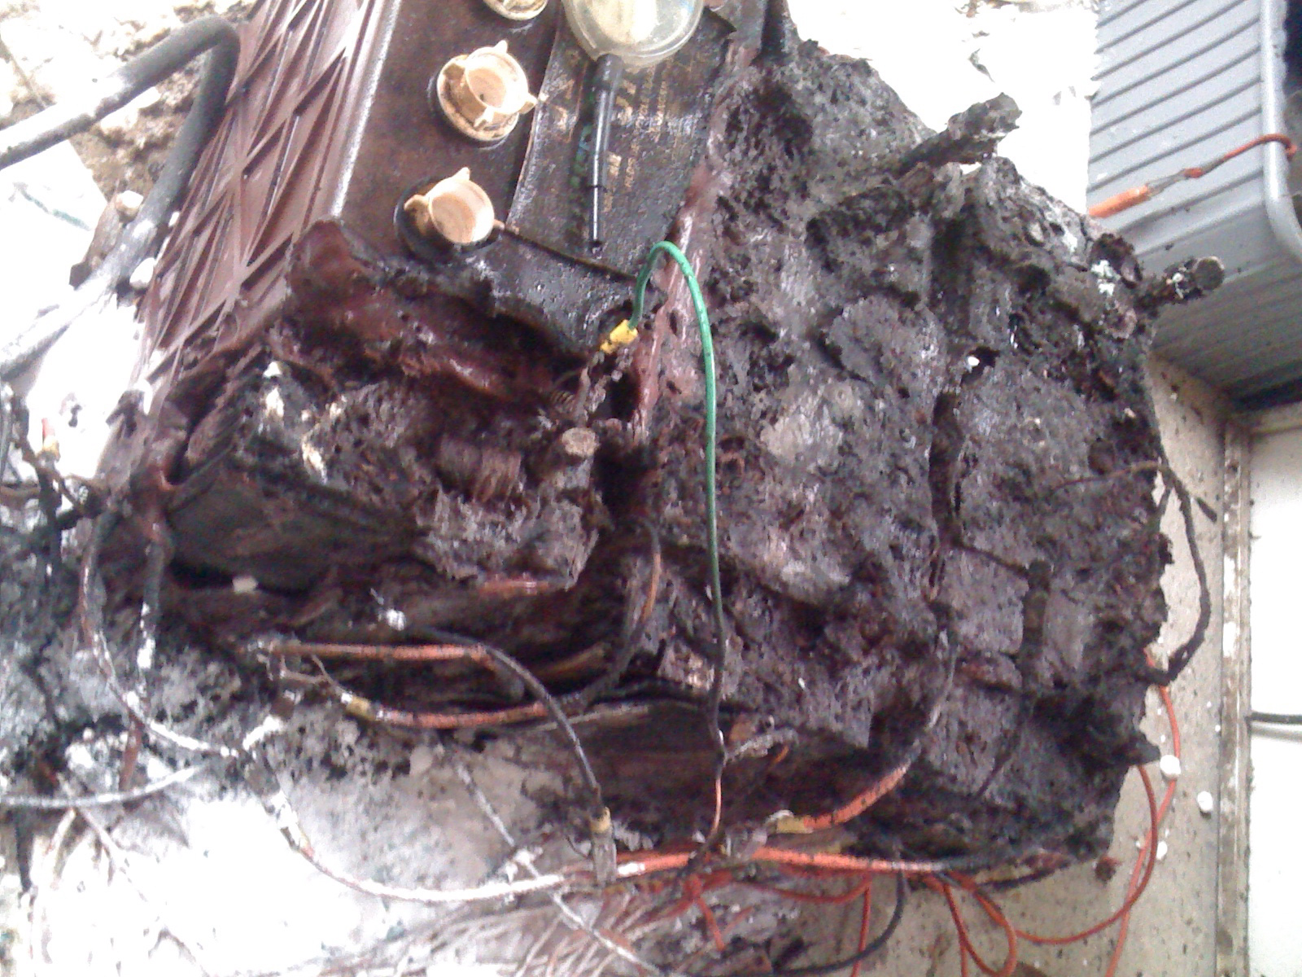
Batteries:
Locate battery storage area
Use CO2, foam, or dry chemical fire extinguishers for lead-acid battery fires
Use Class C extinguishing agents– CO2 or dry chemical – if a PV system shorts and starts a fire
If PV array is engulfed in a roof fire, use water in a fog pattern
Burned/melted lead-acid batteries

Slide 19
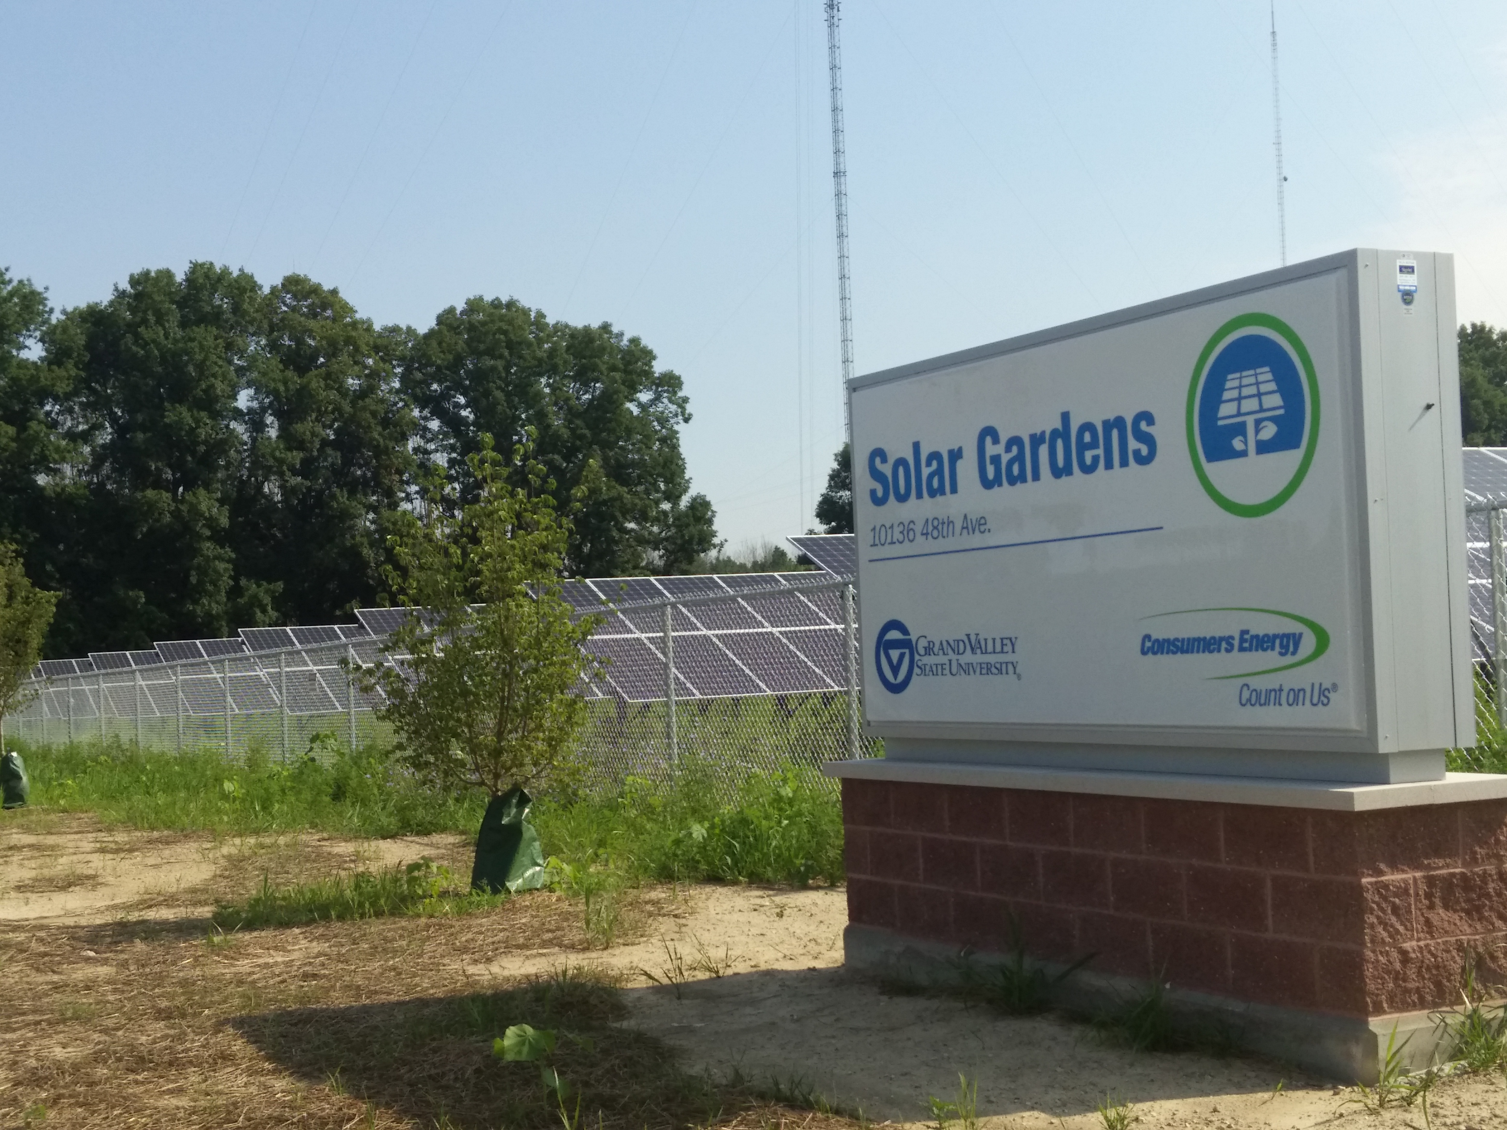
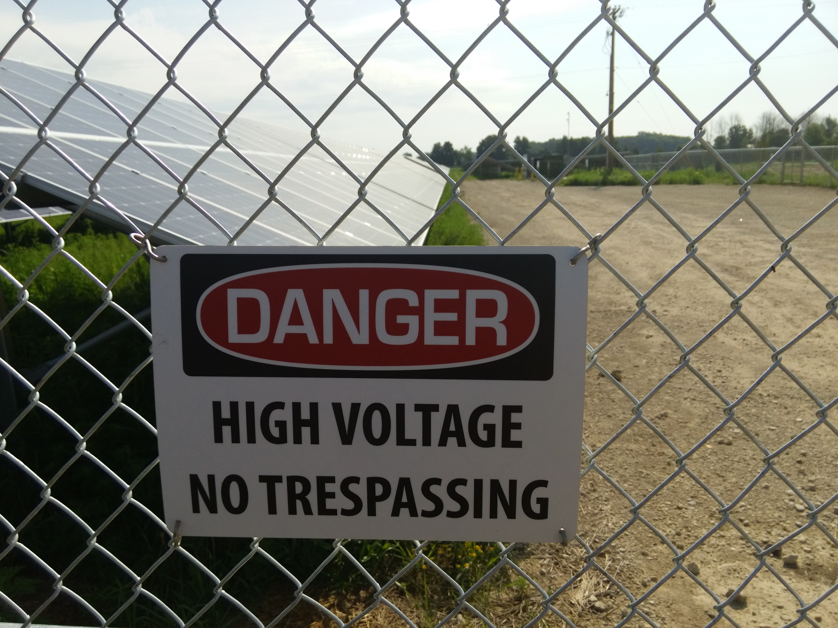
Solar Garden Grand Valley State University

Slide 20
Responding to an Emergency at a Solar Garden
Solar Garden – a large solar installation on the ground that produces solar energy for Consumers Energy electric customers
17 acre Solar Garden at Grand Valley State University in Allendale
10 acre Solar Garden at Western Michigan University in Kalamazoo
Photovoltaic (PV) array will always generate electricity
Treat all PV equipment as energized
Do not cut into any PV equipment
Do not open combiner box
This I where all energized wires from solar panels are fed and combined into two large high-current wires
For more information, visit www.ConsumersEnergy.com/solargardens

Slide 21
Safety Hazards in a Solar Garden
Electrical shock/burns
Even if it is dark, solar panels could be energized from structure fire
Contact with electricity can cause a slight tingling sensation, involuntary muscle reaction, severe burns, or even death
Electrical burns can be arc or thermal
Arc temperatures can reach 15,000 to 35,000 degrees
Ground hazards
Uneven terrain
Ground-mounted arrays
Local wildlife habitat
Do not cut any electrical conduits
Do not pull the electric meter to shut off power to a building
Electric meter

Slide 22
First Responder Resources from Consumers Energy
Dedicated Public Safety Outreach team
Password protected Emergency Officials portal
Request access
First responder guides
For additional questions or to request access to their Emergency Officials portal or first responder guides contact their public Safety Team at publicsafety@cmsenergy.com or visit www.ConsumersEnergy.com/safety

Slide 23
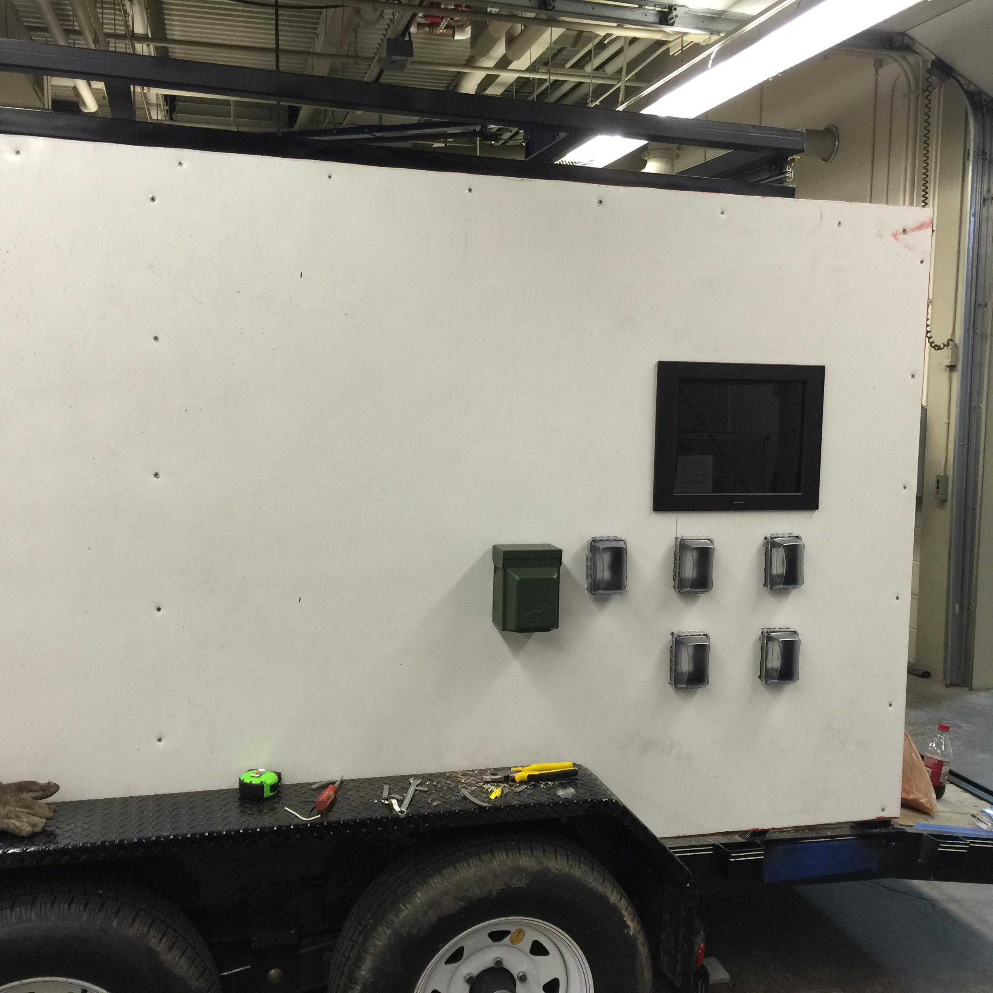
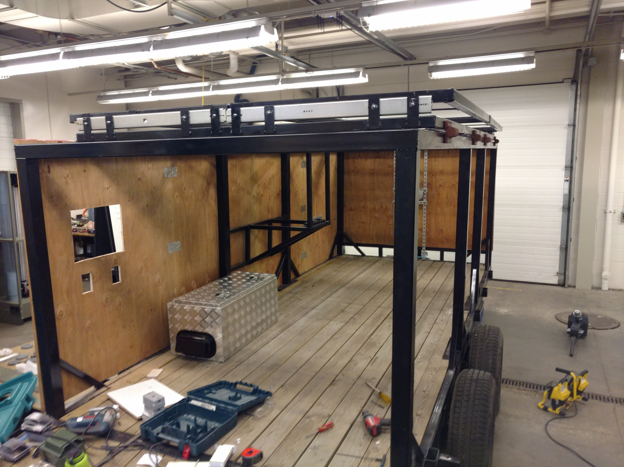
GVSU Engineering Department Solar Project
Pictures of Solar Trailer:

Slide 24
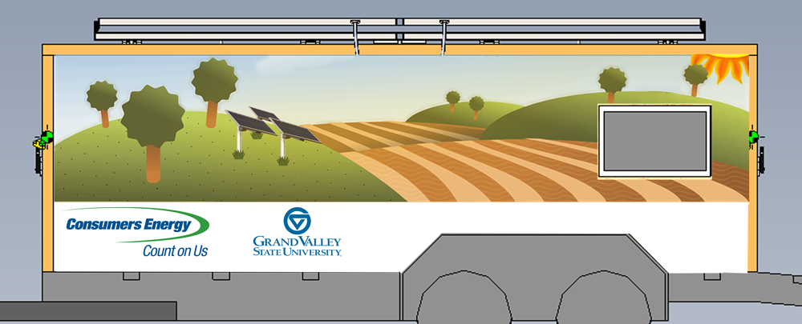
Solar Trailer GVSU Engineering

Slide 25
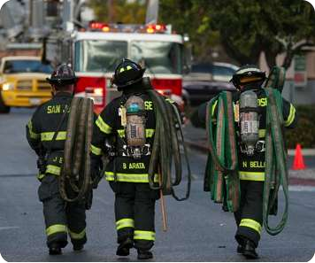
References
Brooks, Bill, Brooks Engineering, and Code Official Panel. "Solar PV Safety for the Fire Service." Solar America Board for Codes and Standards. University of Central Florida, 2015. Web. July 2016.
Cal Fire: Office of the State Fire Marshal. "Photovoltaics." CA.Gov. State of California, 2013. Web. July 2016.
Consumers Energy. Responding to an Emergency at a Solar Garden. N.p.: Consumers Energy, 2016. Print.
"Firefighter Safety and Photovoltaic Systems." LearnShare. Underwriters Laboratories Inc., 2011. Web. July 2016.
Grant, Casey C., P.E. Fire Fighter Safety and Emergency Response for Solar Power Systems. Rep. Fire Protection Research Foundation, May 2010. Web. July 2016.
Craig Allyn Rose Photography - Emergencyphoto.com

